Slide 1
MARKETPLACE TECHNICAL FOUNDATION -[Furniro]
The furniture Marketplace

Slide 2
Furniro-The Furniture Marketplace
Furniro, an online platform for furniture , based on both E-Commerce and M-Commerce , is a convenient online marketplace accessible from all three gadgets i.e. Mobile , Tablet and Laptop.
It is a responsive design , Keeping in mind the ease of customers to access, order and to get it delivered.
As per Requirement of Day 5 ,UI/UX with API Integration is tested from different perspects
Let’s take a look ..

Slide 3
Furniro-The Furniture Marketplace
KEY FEATURES:
This marketplace provides a complete range of furniture for offices/home/schools, from beds to porch , from conference room to cabins..
Comprehensive product cards provides details on the go..
Cart facilitates to make your shopping list..
Drop Shipping is also included in plan..
Sanity CMS is used to add details of products in inventory..
Professional UI/UX, also adds customer’s feedback ..
Delivery service is also added..

Slide 4
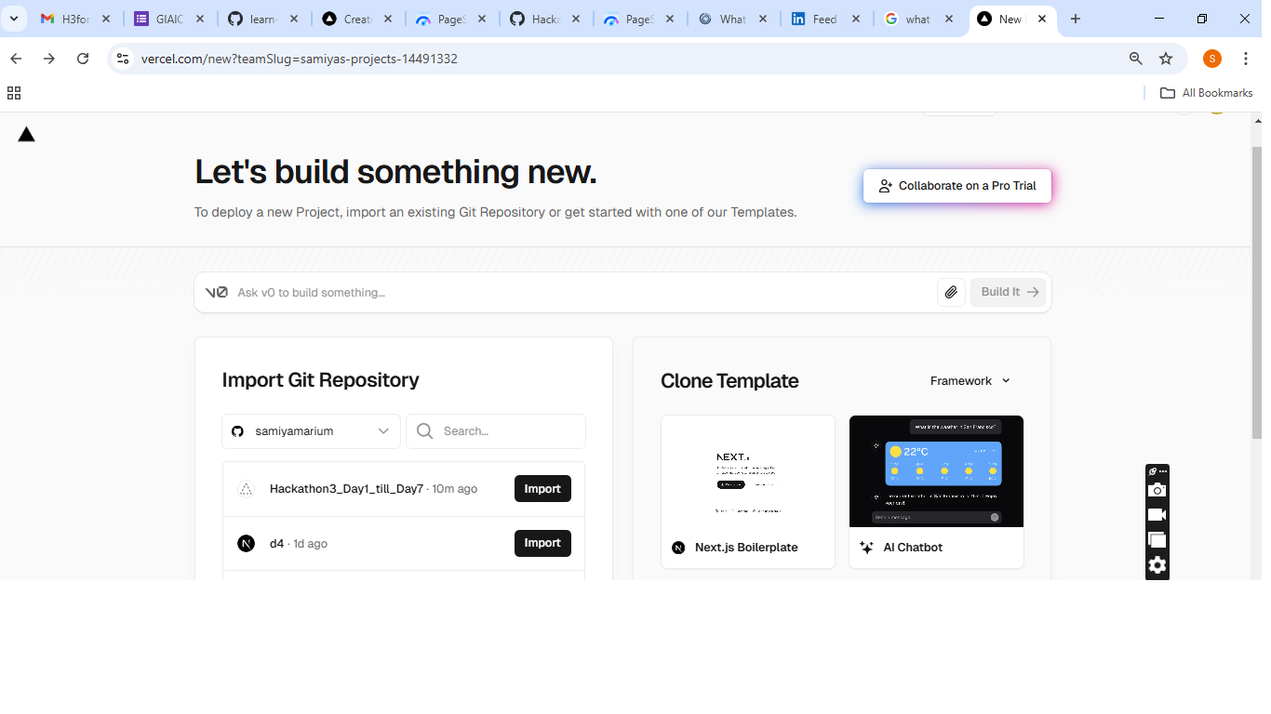
Furniro-The Furniture Marketplace Staging deployment-selected vercel

Slide 5
Furniro-The Furniture Marketplace Staging deployment-link & Backend Services
https://d4-sooty.vercel.app/
Backend:SanityCMS

Slide 6
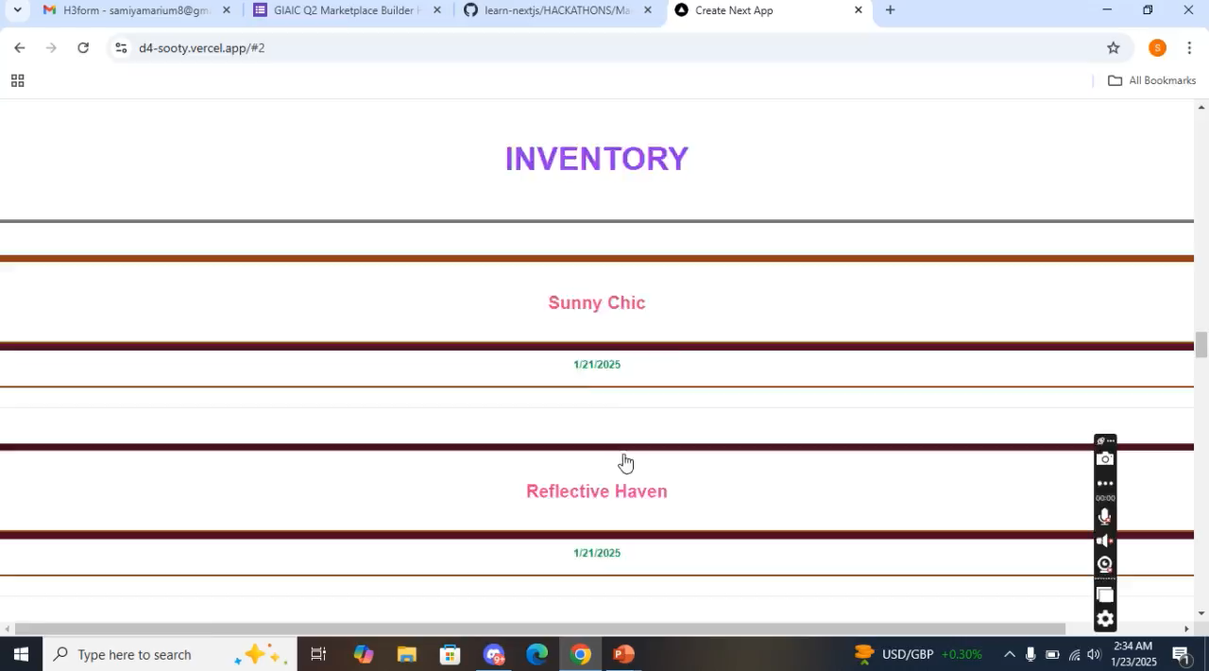
Furniro-The Furniture Marketplace Functional test –Video demonstration

Slide 7
Furniro-The Furniture Marketplace Error Handling
Used "eslint-disable @typescript-eslint/no-explicit-any”
to avoid no-explicit-any error during build..
Used “ eslint: {
// Warning: This allows production builds
to successfully complete even if
// your project has ESLint errors.
ignoreDuringBuilds: true,
},”
to ignore elsint error hindering build..

Slide 8
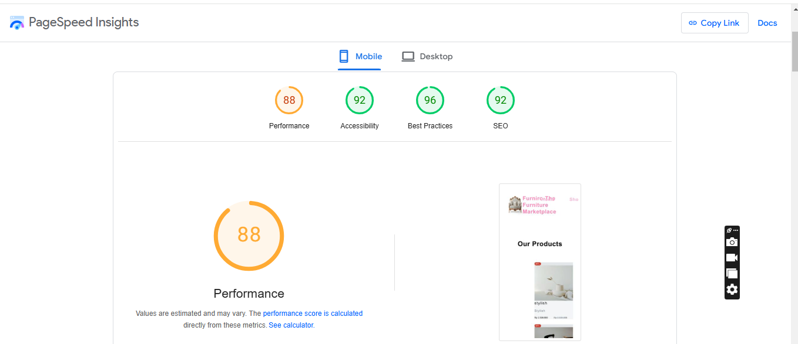
Furniro-The Furniture Marketplace Performance test-mobile

Slide 9
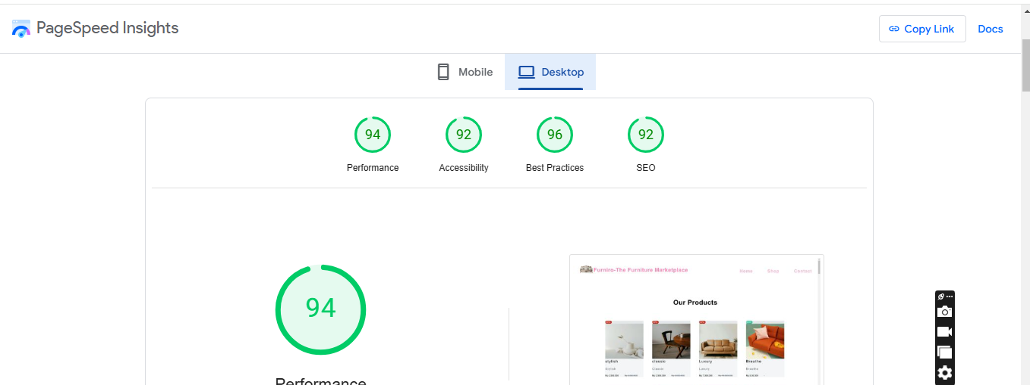
Furniro-The Furniture Marketplace Performance test-Desktop

Slide 10
Furniro-The Furniture Marketplace Cross-Browser test/ Security/UAT
Tests performed on Microsoft edge and chrome..
Running/working perfectly fine for both..
API keys are not mentioned in frontend, So they are secure..
UAT is performed by testing on different devices, keeping responsiveness as metric..

Slide 11

.

